Slide 1
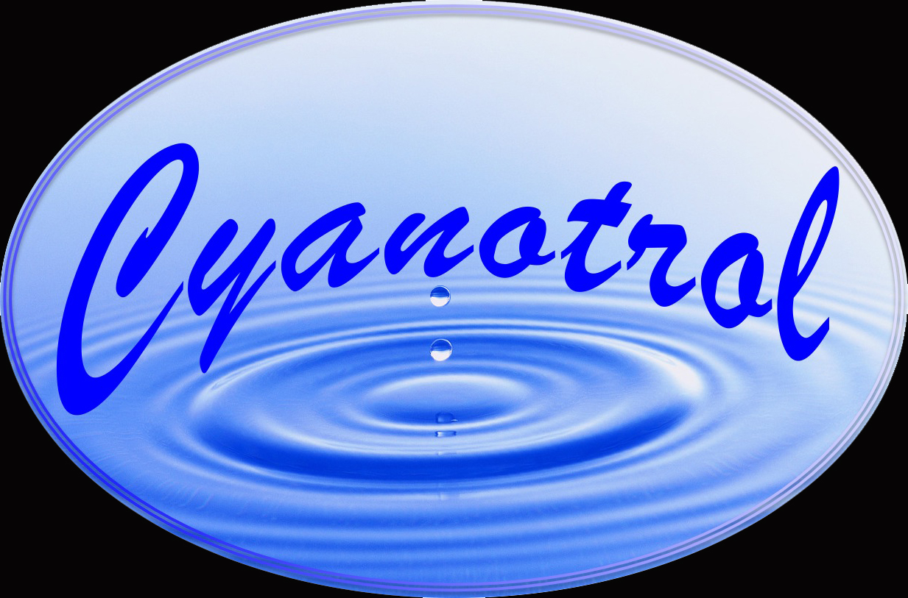
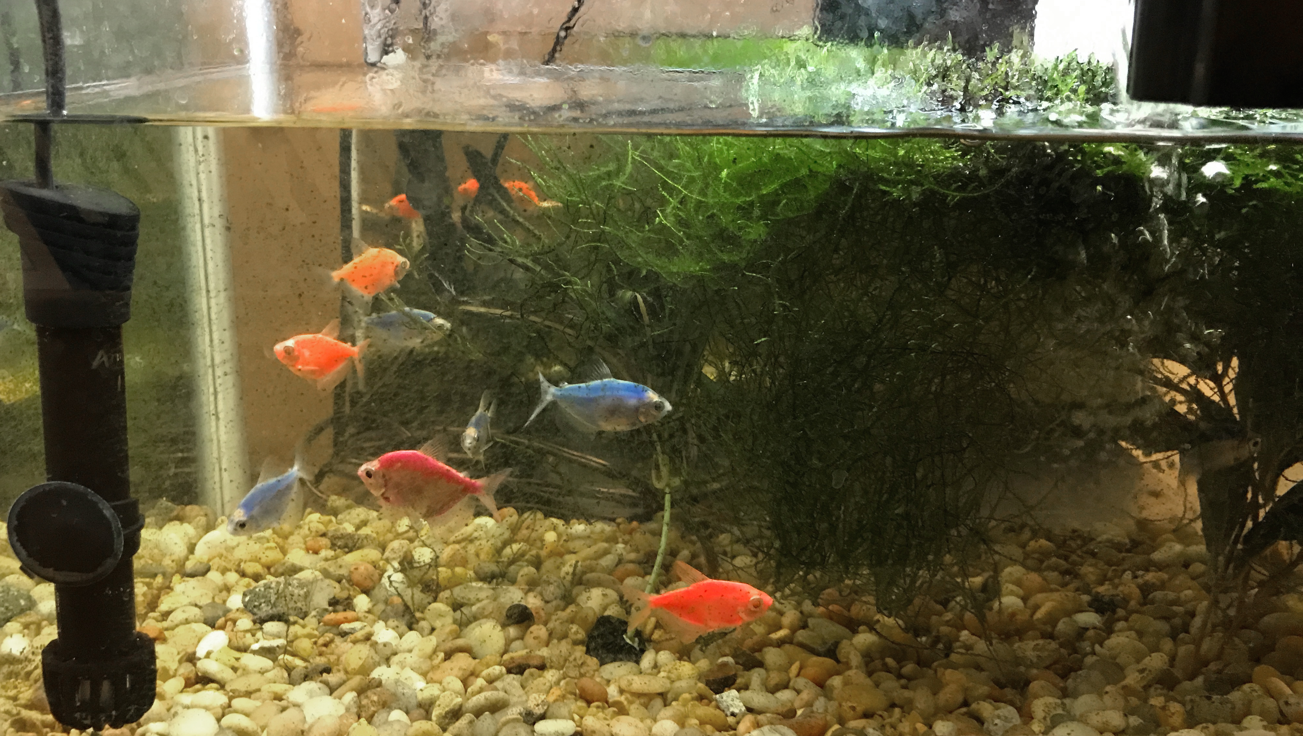
No More Water Changing*
No More Cleaning
Eliminate Harmful Algal Bloom
Patented Natural Product Derivative that Prevents and Stops Harmful Blooms
Caused by Cyanobacteria
Safe to Fishes, Shrimps, Snails and Plants
No Effect on Beneficial Green Algae
Sunlit home aquarium
more than one year without
water changing or cleaning
For more information, visit
www.cyanotrol.com
*Tested for 15 months

